Slide 1
IMAGE INPAINTING BASED ON GENERATIVE ADVERSARIAL NETWORKS
-MADONNA THOMAS
MCA B BATCH

Slide 2
CONTENT
INTRODUCTION
RELEVANCE OF THE TOPIC
DESCRIPTION OF PROJECT
OBJECTIVES
EXISTING AND PROPOSED SYSTEM
METHODOLOGY
DATASETS

Slide 3
INTRODUCTION
Image inpainting aims to fill missing regions of a damaged image with plausibly synthesized content. It aims to fill the missing or masked regions of the image with generated content and make the repaired image visually realistic. The completion model based on proposed algorithm contains one generator, one global discriminator, and one local discriminator.

Slide 4
RELEVANCE
Image inpainting is a research field of image processing.
It aims to fill the missing or masked regions of the image with generated content.
Make the repaired image visually realistic.
Image inpainting technology has been widely applicated in many
Image inpainting can restore coherently both texture and structure components of the image.

Slide 5
DESCRIPTION
Image inpainting aims to fill missing regions of a damaged image with plausibly synthesized content.
Combined with the characteristics of skip-connection and Auto-Encoders.
Skip-connection in the generator, which can help us use the underlying network to enhance the prediction ability of the decoding process, and prevent the gradient vanishing caused by the deep neural network.
The architecture of dual discriminators: global discriminator and local discriminator.
Wasserstein GAN loss is used to train our model, which can ensure our model’s stable training.

Slide 6
OBJECTIVES
Fill the missing or masked regions of the image with generated content.
Fill missing regions of a damaged image.
Make the repaired image visually realistic.
Widely applicated in medical image processing, book restoration and Photoshop processing.

Slide 7
EXISTING SYSTEM
Existing methods for image inpainting either fill the missing regions by borrowing information from surrounding areas or generating semantically coherent content from region context.
Due to the complexity of the natural images, there will be obvious fuzzy phenomena in the region of the repaired image and the boundary between the original region and the repaired region, which is a main difficult issue in the work of image inpainting.

Slide 8
In order to address these problems of image inpainting, existing methods categorize into two types:
One category is texture synthesis methods based on the patch, the main idea is to find the boundary of the missing region to fill in the missing part of the image.
The other is methods based on the Convolution Neural Networks(CNNs), the main idea is to extract the features of the image through the deep convolution neural network to understand the image, and then to fill the missing region.

Slide 9
PROPOSED SYSTEM
A novel approach based on Wasserstein GAN for image inpainting is proposed. Wasserstein GAN is used to ensure the model’s stable training.
Skip-connection is added to the generative model of autoencoder architecture to enhance the prediction ability of the generated model.
Skip-connection is added between the encoder and the decoder.
The inpainting framework proposed can be applied to the task of image super-resolution and image denoising.

Slide 10
METHODOLOGY
First introduce the problem formulation and some basic symbols.
Detail the framework proposed and the objective function: Given an incomplete image, the purpose of model is to fill the missing region of the image so that the entire image is visually and semantically plausibly realistic.
Propose the algorithm of training our model : Propose an image inpainting algorithm for training.

Slide 11
The mini-batch training method is used to occlude the image of the dataset in each iteration.
Firstly, sample a mini-batch of images and mask them with random holes.
Fix the generator and train discriminators ,after training the generator.
Finally, train the joint model with joint loss. Input into the model and output the predicted images. Combining the masked regions, get the final inpainting images.

Slide 12
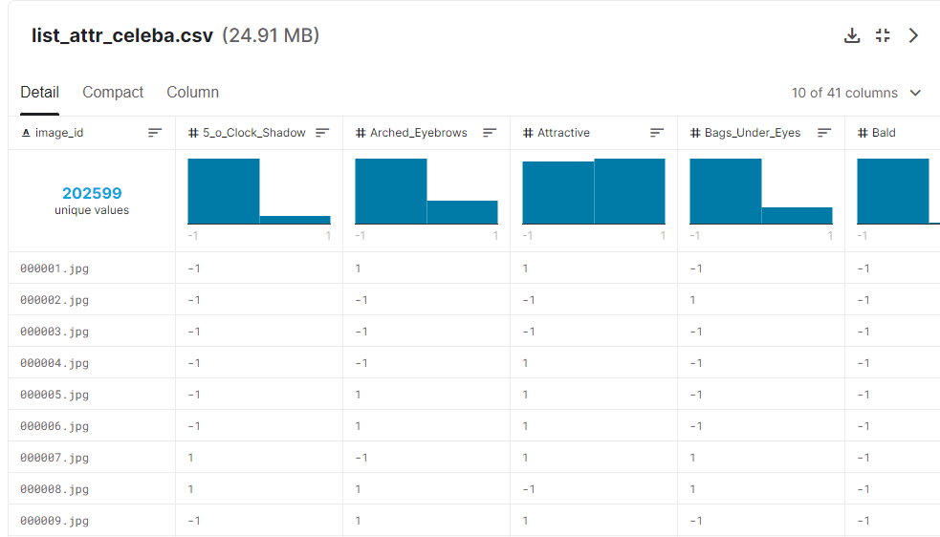
DATASET
CelebA dataset is used to learn and to evaluate model. CelebA dataset contains 202599 RGB color facial image. 100k is used for training and 1000 images for testing.

Slide 13
THANK YOU !

